Slide 1

Pitch Deck
AIR QUALITY MONITORING SYSTEM
CHERYL RACHAEL MAKOKHA
08 September, 2024
DATABASE MODULE

Slide 2
Addressing Sustainable Development Goals (SDGs)
DATABASE MODULE

Slide 3
TABLE OF CONTENTS
Project Overview
SDG Alignment
Problem Definition
Database Design
Database Schema Diagram
Data Analysis Insights
Excel Dashboard Demonstration
Project Delivery
Conclusion
DATABASE MODULE

Slide 4
PROJECT OVERVIEW
Objective:
To monitor and analyze air quality data to address pollution levels.
Key Features:
Real-time data collection
Data analysis and visualization
Integration with SDGs
DATABASE MODULE

Slide 5
SDG ALIGNMENT
Relevant SDGs:
SDG 3: Good Health and Well-being
SDG 11: Sustainable Cities and Communities
SDG 13: Climate Action
Impact:
Improving air quality leads to better health outcomes, sustainable urban living, and climate mitigation.
DATABASE MODULE

Slide 6
PROBLEM DEFINITION
Significance:
Air pollution causes respiratory and cardiovascular diseases.
Urban areas are significantly impacted.
Need for effective monitoring and intervention strategies.
Increasing air pollution levels pose a risk to public health and the environment.
DATABASE MODULE

Slide 7
DATABASE DESIGN
Entities:
Stations (StationID, Location, etc.)
Pollutants (PollutantID, PollutantName, etc.)
Measurements (MeasurementID, StationID, PollutantID, Value, Timestamp)
Relationships:
Each station has multiple measurements.
Each pollutant is measured at multiple stations.
DATABASE MODULE

Slide 8
DATABASE SCHEMA DIAGRAM
Stations
Pollutants
Measurements
StationID (Primary Key)
Location
Description
PollutantID (Primary Key)
PollutantName
Unit
MeasurementID (Primary Key)
StationID (Foreign Key to Stations)
PollutantID (Foreign Key to Pollutants)
Date
Time
Value
DATABASE MODULE

Slide 9
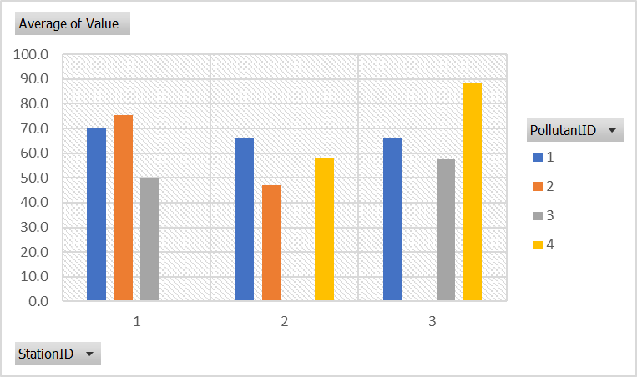
DATA ANALYSIS INSIGHTS
Average Pollutant Levels
Pollutant 1 is consistently measured across all three stations and maintains relatively high average values, indicating its significant presence in all locations.
Pollutant 2 shows the highest average value at Station 1 but is not measured at Station 3.
Pollutant 3 is measured at Stations 1 and 3 with significant average values, but not at Station 2.
Pollutant 4 is not measured at Station 1 but shows a significant presence at Stations 2 and 3, with the highest average value at Station 3.
DATABASE MODULE

Slide 10
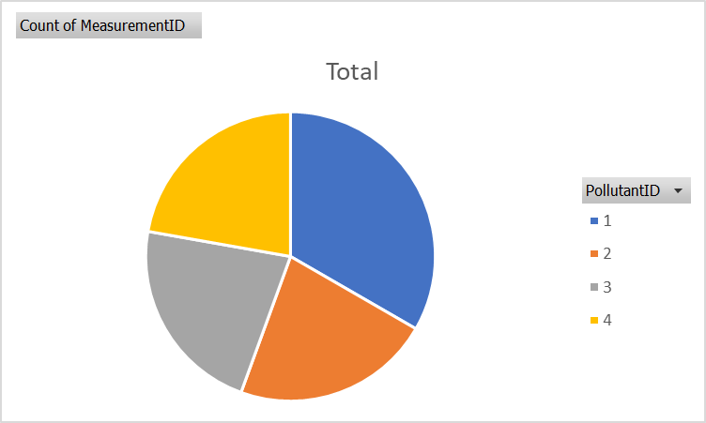
DATA ANALYSIS INSIGHTS
Measurement Counts
The measurement counts for all four pollutants are relatively balanced, with no single pollutant dominating the measurement efforts entirely.
Pollutant 1 has the highest count, indicating that it might be the most prevalent or prioritized pollutant for monitoring.
Pollutants 2, 3, and 4 have similar measurement counts, with Pollutant 4 being monitored slightly more than Pollutants 2 and 3.
DATABASE MODULE

Slide 11
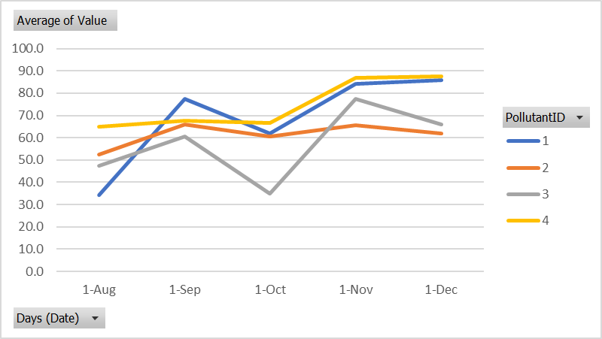
DATA ANALYSIS INSIGHTS
Maximum Pollutant Levels
Pollutant 4 has the highest maximum average value among all pollutants, suggesting an increasing trend that needs attention.
Pollutant 1 also reaches high levels but with more fluctuations, implying sporadic high emissions or measurements.
Pollutants 2 and 3 have lower and more stable average values, with Pollutant 2 being the most stable.
The period from September to November sees a general increase in pollutant levels for most pollutants, indicating potential seasonal factors influencing the concentration levels.
DATABASE MODULE

Slide 12
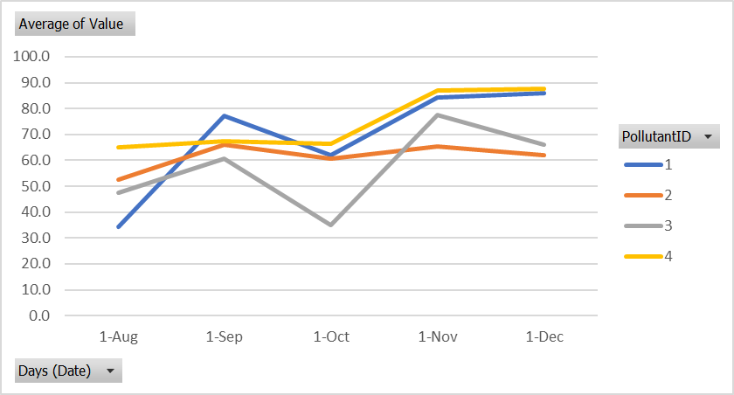
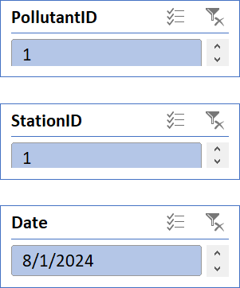
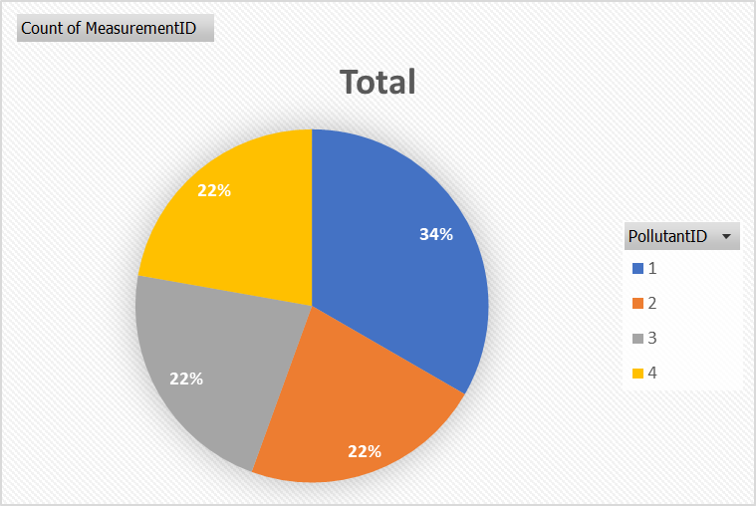
Air Quality Monitoring Dashboard
KEY METRICS | KEY METRICS | KEY METRICS | KEY METRICS | KEY METRICS | KEY METRICS | KEY METRICS | KEY METRICS
KEY METRICS | KEY METRICS | KEY METRICS | KEY METRICS | KEY METRICS | KEY METRICS | KEY METRICS | KEY METRICS
 | 1 | 2 | 3 | 4
TOTAL MEASUREMENTS | 18 | 12 | 12 | 12
AVERAGE POLLUTANT MEASUREMENTS | 64.1 | 63.8 | 64.45 | 66.57
HIGHEST POLLUTANT MEASUREMENTS | 99 | 99 | 89 | 98
LOWEST POLLUTANT MEASUREMENTS | 28 | 22 | 23 | 45

Slide 13
PROJECT DELIVERY
Timeline:
Data Collection: Weeks 1
Database Setup: Weeks 2-3
Data Analysis: Weeks 4
Dashboard Development: Weeks 5
Next Steps:
Deployment and real-time monitoring.
Community engagement and awareness programs.
DATABASE MODULE

Slide 14
CONCLUSION
Summary:
The project successfully monitors and analyzes air quality.
Aligns with key SDGs, contributing to health and sustainability.
Call to Action:
Support and collaborate on expanding the monitoring network.
Leverage insights for policy-making and urban planning.
DATABASE MODULE

Slide 15
Join us in transforming how we understand and address environmental pollution through innovative data analysis and emerging technologies.
DATABASE MODULE

Slide 16
Thank you!
AIR QUALITY MONITORING SYSTEM
CHERYL RACHAEL MAKOKHA
08 September, 2024
DATABASE MODULE

